Slide 1
CS411 Human Computer Interaction
Week 06
The Psychology of Actions

Slide 2
In the Last Lecture
Learning
Thinking
  Reasoning
  Problem-solving
Skill acquisition
Notes:
2

Slide 3
In Class Exercise
From what you have learned about cognitive psychology devise appropriate guidelines for use by interface designers.
You may ﬁnd it helpful to group these under key headings, for example visual perception, memory, problem solving, etc., although some may overlap such groupings.

Slide 4
What can a system designer do to minimize the memory load of the user?

Slide 5

Computer + Press Key
+
=
CHAOS!
Key

Slide 6
London Stock Exchange
London, 1986
Inexperienced operator presses wrong key
Chaos at stock exchange
Systems staff work throughout night at stockbrokers Greenwell Montagu

Slide 7
In Today’s Lecture
Nature of Human being
Blaming
Mental Models
  How mental models are formed?
  Examples
  Applying mental model
  Mental model development
  Mental model perception
Notes:
1

Slide 8
Falsely Blaming the User
A person kept making mistakes when using a computer
Investigation showed others had same problem
Why did you make that error?
Didn’t you read the manual?
My fault
User
Designer

Slide 9
People are Explanatory Creatures
Interact with world
Human tendency to form explanations

Slide 10
Mental Model
Human (uses) understanding (conceptual model) of the way
  Objects work
  Events take place
  People behave
Object
Mental
Model
Conceptual
Model
Perceive
Design
User
Designer
Uses object
Design object

Slide 11
Defining Mental Models
Human (uses) understanding (conceptual model) of the way
  Objects work
  Events take place
  People behave
Models people have of themselves, others, environment and things they interact with
Theories people have to explain what they have observed
Internal constructions (in the human mind) of some aspect of the external world
Knowledge of:
  Learning how to use a system
  Learning how the system works

Slide 12
How Are Mental Models Formed?
Mental model of a device is formed by interpreting perceived actions and visible structure

Slide 13
Manipulating Mental Models
How do things
work ?
develop
apply
Core set of abstractions
Everyday Objects
These could be correct or erroneous

Slide 14
Manipulating Mental Models
Mental models are manipulated
  Enabling prediction
  Making inferences possible
  This process is called ”fleshing out” or “running ” of the mental model
Can involve both unconscious and conscious
mental model

Slide 15
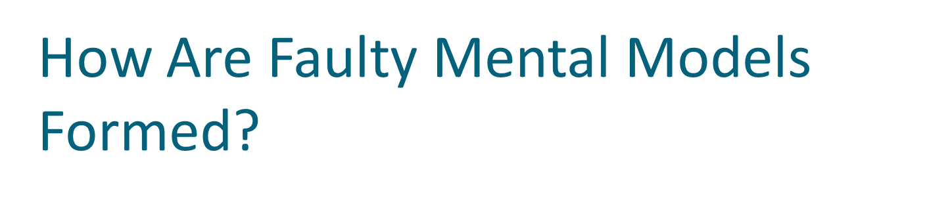

Object
Fragmentary
Evidence
(incomplete info)
Poor
Understanding
Naïve Psychology
Causes
Mechanisms
Relationships
Mental
Model
Faulty

Slide 16
Effect of Faulty Mental Models
If design of an object does not give information (external info) about how it works
Faulty Mental Model
Frustration

Slide 17
Effect of Faulty Mental Models
Computer screen freezes → bash keyboard
TV not working → bang TV top

Slide 18
Activity
To illustrate how we use mental models in our everyday reasoning, imagine the following scenario:
  You arrive home from a holiday on a cold winter’s night to a cold house. You have small baby and you need to get the house warm as quickly as possible. Your house is centrally heated. Do you set the thermostat as high as possible or turn it to the desired temperature (e.g., 70F)

Slide 19
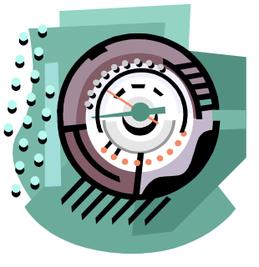
Mental Model - Examples
Thermostat used to control temperature (oven, room, AC)
Folk (name) theories about thermostat
  Timer theory
    Thermostat controls relative properties of time that device stays on.
    Setting
      Midway : device is on about half rime
      All way : device is on full time
  Valve theory
    Thermostat controls how much heat or cold comes out of device
    Setting
      Midway : half cooling
      All way : full cooling
Reality about thermostat
  Thermostat is On-Off switch

Slide 20

Mental Model - Examples
Blander
Mental Model
  There is a pipeline/wire bringing the electricity in device
  It can be On/Off
Actual fact
  Electricity current does not come linearly

Slide 21

Mental Model - Examples
Electricity and electrical appliances
TV
Car brakes
Mental model
  Brakes jam the wheels
Actual fact
  Brakes are attached with many cylinders and different components of the car

Slide 22
Mental Model - Examples
Spreadsheet
  User Mental model: sheet that scrolls with cells containing information
  Reality : data structure of values, with pointers between them, from which the program synthesizes a new image to display in real-time
Screen is the heart of computer (not CPU)
  Perception by normal user

Slide 23
Evolution of Mental Models
More greater use of system, the more their mental model develops
Example: TV
  Engineers Mental model : “deep”
    They know the internal of the TV, so they can fix
  Average citizen’s mental model : “shallow ”
    So they cannot fix, only use

Slide 24

perform
Action (A)
Perceive
Causal Relationship (does not exist!)
see
Result (R)

Slide 25
Mental Models and Perception - Example
Connect to internet to see website ‘x’ [Action]
Suddenly computer goes dead [Result]
Perceive: Action Result

Slide 26

Using a Complex Device
La..La..!!
How am I stupid!

Slide 27

How am I stupid
How am I stupid
How am I stupid
How am I stupid
How am I stupid
How am I stupid !

Slide 28
Blaming the Wrong Cause
When things go wrong
  Own misfortune Environment
  Other’s misfortune Personalities
When things go right
  Own fortune Oneself
  Other’s fortune Environment
blame
blame
Credit
Credit

Slide 29
Reasons for Self-blame
Learned Helplessness
  Failure to perform a task numerous times
    feeling of helplessness
    Depression
Taught Helplessness
  Lack of understanding at one stage hinders progress at another stage
Believe can’t do
Some task next
Time round
Do not
Try
Fail at
A task
Blame Self
Self –fulfilling prophecy

Slide 30
Nature of Human Thought and Explanation
Not easy to see where blame should be placed
  3-Mile Island Accident
  Lockheed L-1011 Flight

Slide 31

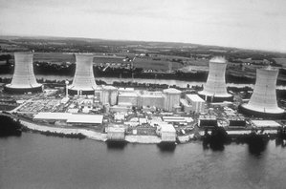
28 March 1979, Pennsylvania, USA
Control Panel
Push button
Valve
Nuclear Core

Slide 32
3-Mile Island Nuclear Power Plant
Accident
Button Pushed
Valve Open
Excess water escapes
From nuclear core
Normal State
Button (Not Pushed)
Valve Open
Excess water escapes
From nuclear core
Action State
Button Pushed
Valve Closes
Excess water cannot escapes
From nuclear core
Button light
(ON)
Button light
(ON)
Button light
(OFF)
Operator knew that Valve was leaky but
Thought it wouldn’t affect main operation

Slide 33

Lockheed L-1011 Flight
Miami, Florida
Nassau, Bahamas
110 miles

Slide 34
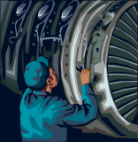
Lockheed L-1011 Flight
Engine 1
Engine 2
Engine 3
Low oil pressure light
Pilot
Engine turned off
8 minute later
Oil Pressure = 0
Oil Pressure = 0
Oil Quantity = 0
Oil Quantity = 0
Pilots concluded = Not likely that all 3 should fail

Slide 35
“To Err is Human”

Slide 36
Errors
People routinely make mistakes
  E.g., corrections made during conversation
  Devices do not have tolerance for things that go wrong
  Push the wrong button chaos

Slide 37
Errors
Developers should design for errors
  Must assume errors will occur
  Minimize errors
  Errors should be easy to detect
  Effects of errors should be minimal
  Effects of errors should be reversible

Slide 38
Errors
Errors
Slips
Mistakes
Automatic behavior
Conscious
deliberations

Slide 39
Errors are Based On Goals
Correct Goal
Incorrect Goal
Wrong Execution
(due to lack of attention)
Wrong/Right
Execution
Slip
(easy to discover)
Mistake
(harder to discover)

Slide 40
Errors are Based On Goals
Most everyday errors are slips
Study of slips
  Study of the psychology of everyday errors
  “Psychopathology of everyday life” – Freud
  Example
    You went to fetch a book, but fetched a pen instead
Slips show up in skilled behavior
We can do more than one thing if we do them automatically

Slide 41
Word of Advice
Don’t press the wrong key!

